Slide 1

Behaviour Driven Development :
roots

Slide 2
BDD :
roots
Introduction
Full BDD example on a library
Improve the process with
Conclusion

Slide 3
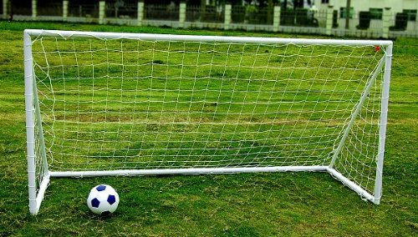

Introduction
Goal : make you want to try
or try the BDD again
Notes:
Qui suis je : développeur décomplexé ayant eu des expériences diverses avec le BDD (échecs et succès)
But: donner envie d'essayer ou de réessayer le BDD
Spécification par l'exemple par l'exemple
Retirer la magie
Trucs et astuces issu de la pratique
Pour ceux qui l'on pratiquer : une approche différente

Slide 4

Introduction
A product owner during the demo of the product after an iteration
Notes:
L'expression des besoins est difficile :
Des éléments sous entendu peuvent être oublié lors du développement
Des cas d'erreur ou cas limites peuvent être géré que lors du développement
Sans cas précis, l'interprétation du besoin exprimé peut divergé du besoin réel
La boucle de rétro action est trop longue entre l'expression du besoin et la démonstration du produit

Slide 5
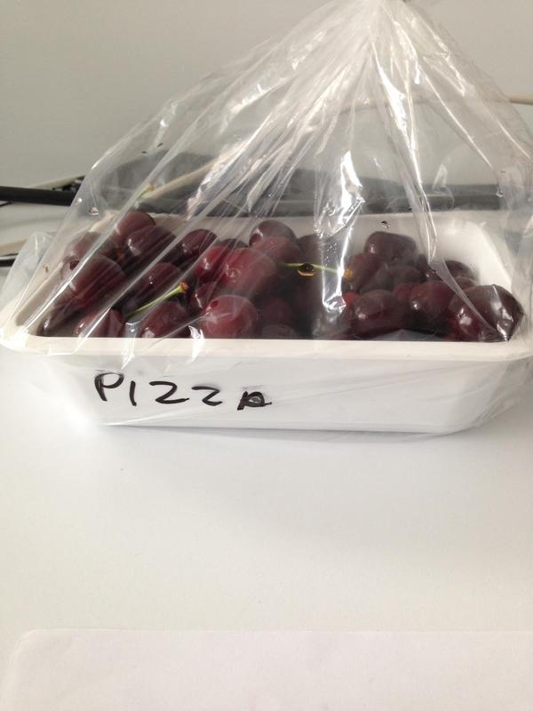
Introduction
Functional documentation
after many iterations
and readjustments of the need
Notes:
Documentation fonctionnelle : peu de confiance
Dans un cycle itératif de développement la documentation suit difficilement l'état réel du produit.
On ne peut jamais savoir si la documentation est juste, même si elle l'est.

Slide 6

Introduction
Functional tests that flash
Non-exhaustive functional tests
Notes:
Lors que les tests fonctionnels sont écrit après :
Ne sont pas exhaustifs
Sont difficiles à écrire
Peuvent clignoter s'ils sont basés sur les données vivantes

Slide 7
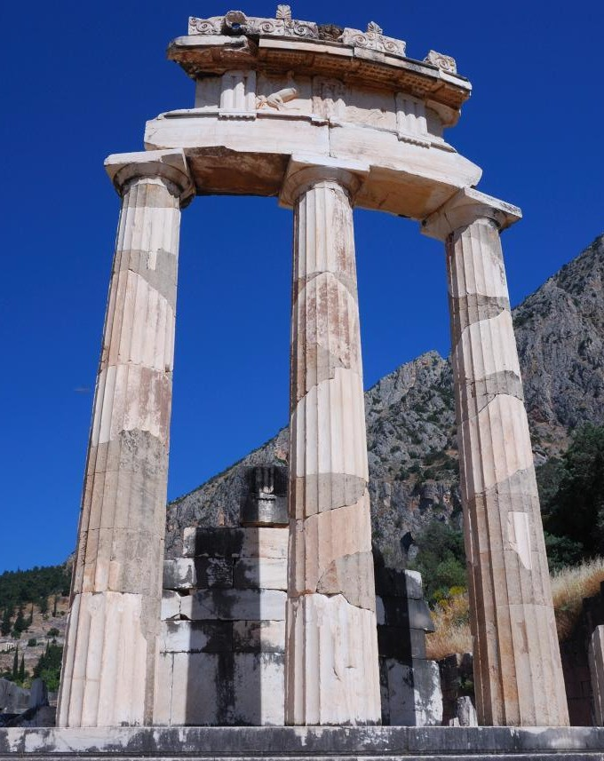
Introduction
Behavior Driven Development
Specification by example
Functional tests
Executable documentation

Slide 8
Introduction
Specification by example
Scenario: suggested suggestions are popular, available
and adapted to the age of the user
Given the user "Tim"
and he is "4" years old
and the popular categories for this age are
| categoryId | name |
| cat1 | Walt Disney |
| cat2 | Bedtime stories |
and the available books for those categories are
| bookId | bookTitle | categoryId |
| lv11 | Peter Pan | cat1 |
| lv21 | The tortoise and the hare | cat2 |
When we ask for "2" suggestions
Then the suggestions are
| bookId | bookTitle | categoryId |
| lv11 | Peter Pan | cat1 |
| lv21 | The tortoise and the hare | cat2 |

Slide 9
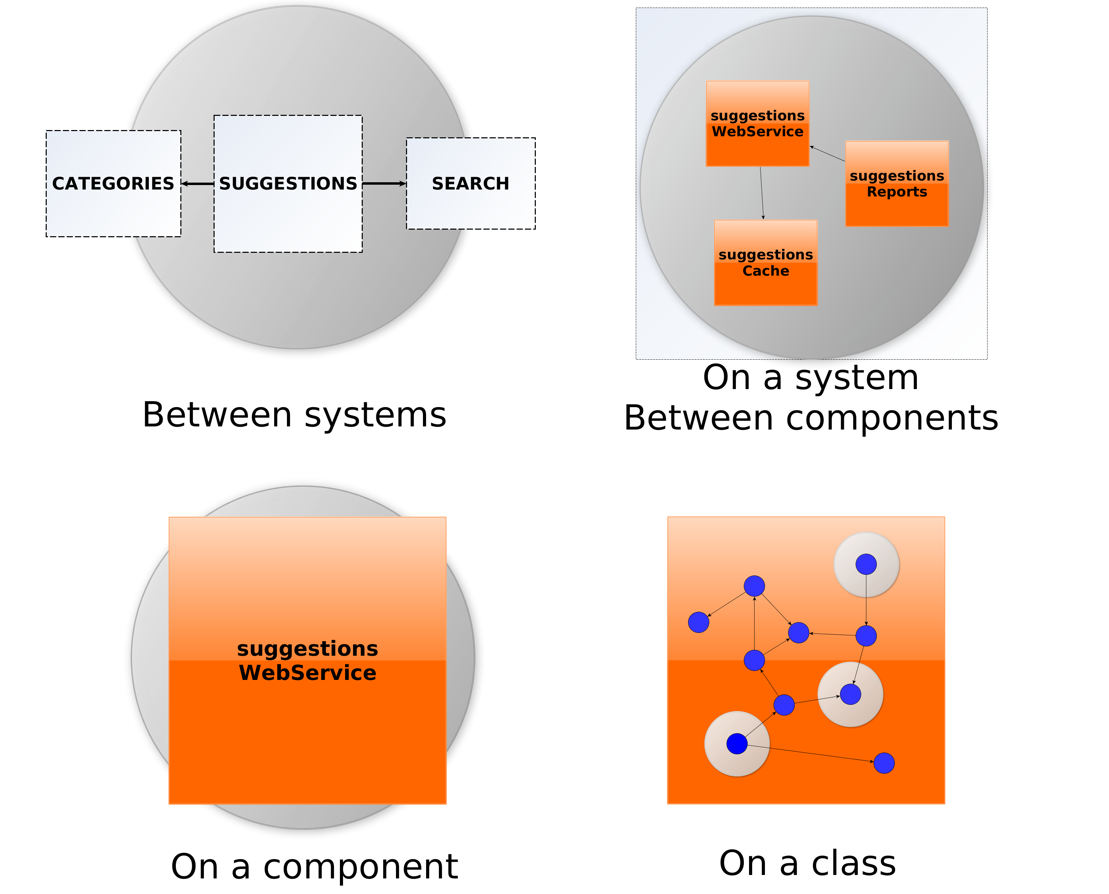
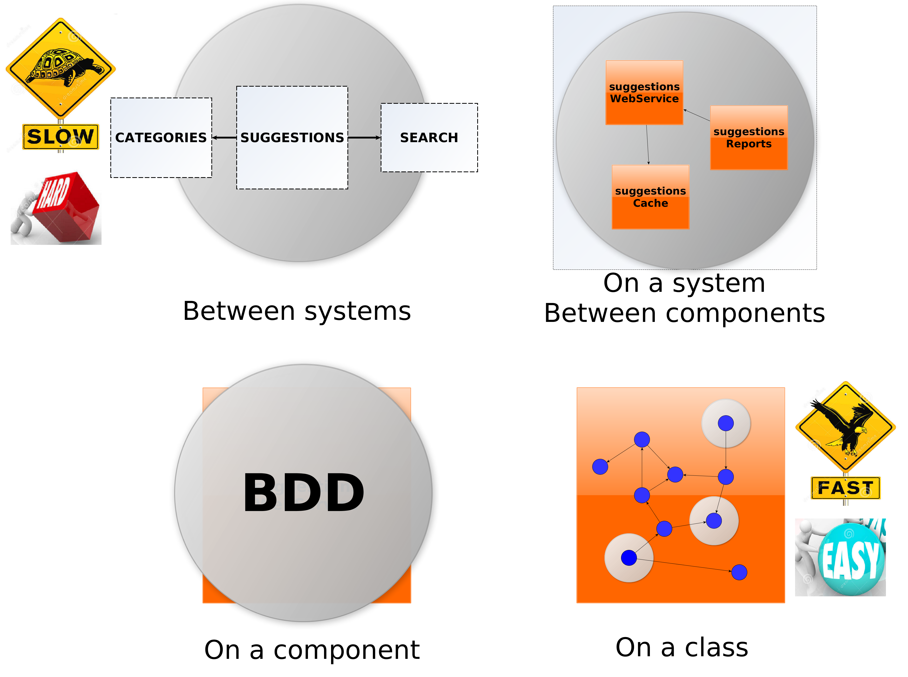
Introduction
Functional tests

Slide 10
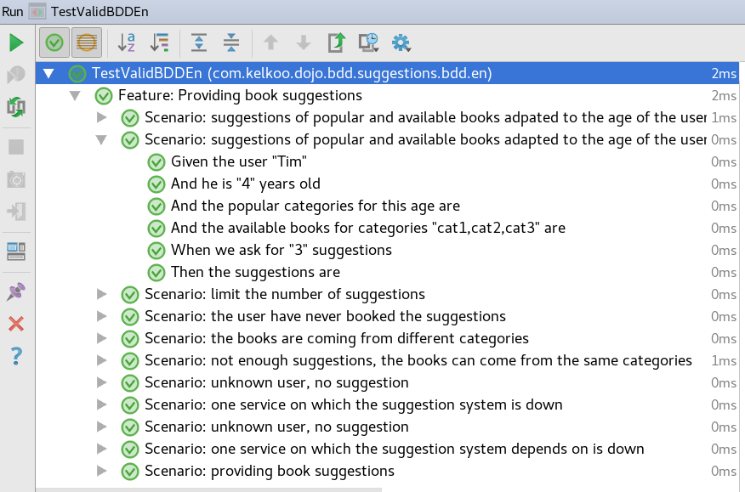
Introduction
Functional tests

Slide 11
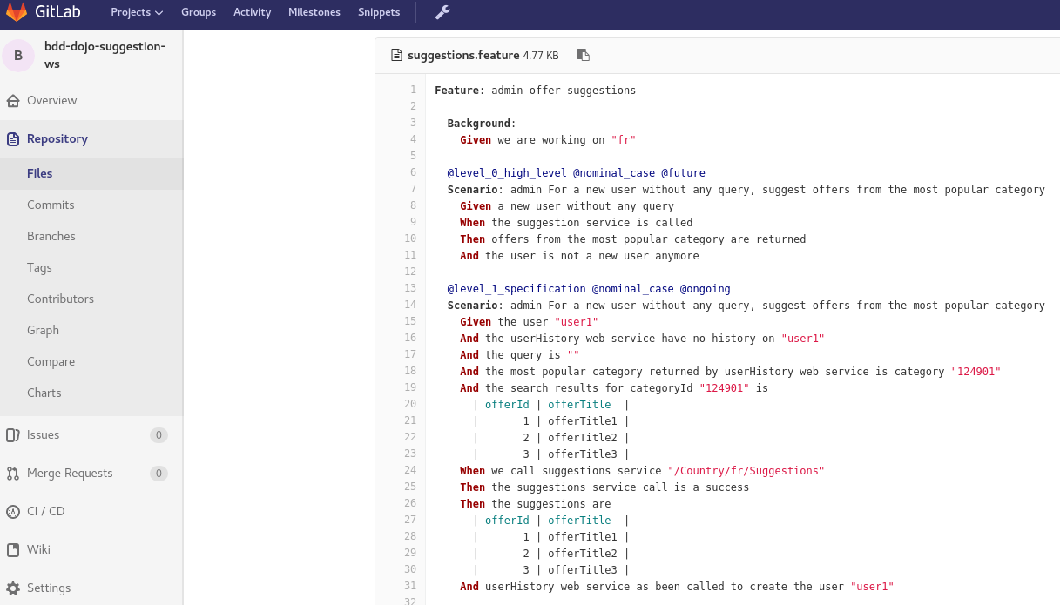
Introduction
Executable Documentation

Slide 12
Library
User Story to be implemented
PO
DEV

Slide 13
Library
User Story to be implemented
Users
Categories
Users, ages, books already red...
Categories of books, popular categories by age
User
Booking
Suggestions
Search
Booking service,
Available books
Provides book suggestions
Provides books,
textual search,
multi-criteria search
(category, popularity, availability ...)

Slide 14
Library
User Story to be implemented
As a user of the library,
I wish to book suggestions
to make discoveries
Acceptance criteria :
- Book not read by the user
- Book available

Slide 15
Library
User Story to be implemented
User Story
As a user of the library, I wish to book suggestions to make discoveries
PO
PO
For a better discovery, the books must come from different categories
Suggestions must be appropriate to the age of the user

Slide 16
Library
User Story to be implemented
User Story
As a user of the library, I wish to book suggestions to make discoveries
DEV
Focus on how to recover books, forgets that the book must be unread by the user
The simplest way : research the popularity of books

Slide 17
Library
Write scenarios in collaboration
PO
PO
Scenario: provide book suggestions
Given a user
When we ask for suggestions
Then the suggestions are popular and
available books adapted to the age of the user
Missing examples !

Slide 18
Library
Write scenarios in collaboration
PO
PO
DEV
Scenario: provide book suggestions
Given the user "Tim"
And he is "4" years old
And the popular categories for this age are
| categoryId | name |
| cat1 | Walt Disney |
| cat2 | Picture books |
| cat3 | Bedtime stories |
And the available books for categories "cat1,cat2,cat3" are
| bookId | title | categoryId |
| lv11 | Peter Pan | cat1 |
| lv21 | Picture book about farm | cat2 |
| lv31 | The tortoise and the hare | cat3 |
When we ask for "3" suggestions
Then the suggestions are
| bookId | title | categoryId |
| lv11 | Peter Pan | cat1 |
| lv21 | Picture book about farm | cat2 |
| lv31 | The tortoise and the hare | cat3 |
Missing limit number of suggestions
Missing : never read
Missing : different categories

Slide 19
Library
Write scenarios in collaboration
PO
PO
DEV
Scenario: provide book suggestions
Given the user "Tim"
And he is "4" years old
And the popular categories for this age are
| categoryId | name |
| cat1 | Walt Disney |
| cat2 | Picture books |
| cat3 | Bedtime stories |
And the available books for categories "cat1,cat2,cat3" are
| bookId | title | categoryId |
| lv11 | Peter Pan | cat1 |
| lv21 | Picture book about farm | cat2 |
| lv31 | The tortoise and the hare | cat3 |
When we ask for "3" suggestions
Then the suggestions are
| bookId | title | categoryId |
| lv11 | Peter Pan | cat1 |
| lv21 | Picture book about farm | cat2 |
Missing : never read
3
Missing : different categories
limit number of suggestions
2

Slide 20
Library
Write scenarios in collaboration
PO
PO
DEV
Scenario: provide book suggestions
Given the user "Tim"
And he is "4" years old
And the popular categories for this age are
| categoryId | name |
| cat1 | Walt Disney |
| cat2 | Picture books |
| cat3 | Bedtime stories |
And the available books for categories "cat1,cat2,cat3" are
| bookId | title | categoryId |
| lv11 | Peter Pan | cat1 |
| lv12 | Pinocchio | cat1 |
| lv21 | Picture book about farm | cat2 |
| lv31 | The tortoise and the hare | cat3 |
When we ask for "2" suggestions
Then the suggestions are
| bookId | title | categoryId |
| lv11 | Peter Pan | cat1 |
| | | |
| lv21 | Picture book about farm | cat2 |
Missing : never read
4
different categories
2

Slide 21
Library
Write scenarios in collaboration
PO
PO
DEV
Scenario: provide book suggestions
Given the user "Tim"
And he is "4" years old
And the popular categories for this age are
| categoryId | name |
| cat1 | Walt Disney |
| cat2 | Picture books |
| cat3 | Bedtime stories |
And the available books for categories "cat1,cat2,cat3" are
| bookId | title | categoryId |
| lv11 | Peter Pan | cat1 |
| lv12 | Pinocchio | cat1 |
| lv13 | Bamby | cat1 |
| lv21 | Picture book about farm | cat2 |
| lv31 | The tortoise and the hare | cat3 |
And the user has already booked the following books
| bookId | title | categoryId |
| lv11 | Peter Pan | cat1 |
When we ask for "2" suggestions
Then the suggestions are
| bookId | title | categoryId |
| | | |
| lv12 | Pinocchio | cat1 |
| lv21 | Picture book about farm | cat2 |
What are we testing ? Prefer several scenario
5
Never read
2

Slide 22
Library
Write scenarios in collaboration
PO
PO
DEV
Scenario: suggested suggestions are popular, available
and adapted to the age of the user
Given the user "Tim"
And he is "4" years old
And the popular categories for this age are
| categoryId | name |
| cat1 | Walt Disney |
| cat2 | Picture books |
And the available books for categories "cat1,cat2" are
| bookId | title | categoryId |
| lv11 | Peter Pan | cat1 |
| lv21 | Picture book about farm | cat2 |
When we ask for "2" suggestions
Then the suggestions are
| bookId | title | categoryId |
| lv11 | Peter Pan | cat1 |
| lv21 | Picture book about farm | cat2 |
Scenario 1 : nominal case
=> minimal

Slide 23
Library
Write scenarios in collaboration
PO
PO
DEV
Scenario: limit number of suggestions
Given the user "Tim"
And he is "4" years old
And the popular categories for this age are
| categoryId | name |
| cat1 | Walt Disney |
| cat2 | Picture books |
And the available books for categories "cat1,cat2" are
| bookId | title | categoryId |
| lv11 | Peter Pan | cat1 |
| lv21 | Picture book about farm | cat2 |
When we ask for "1" suggestions
Then the suggestions are
| bookId | title | categoryId |
| lv11 | Peter Pan | cat1 |
Scenario 2 : nominal case
2
1
Simplify it again !

Slide 24
Library
Write scenarios in collaboration
PO
PO
DEV
Scenario: limit number of suggestions
Given a user
And "3" books are available in popular categories
adapted to his age
When we ask for "2" suggestions
Then "2" suggestions are proposed
among the previous books
Scenario 2 : nominal case

Slide 25
Library
Write scenarios in collaboration
PO
PO
DEV
Scenario: the user has never red the books that are suggested
Given the user "Tim"
And he is "4" years old
And the popular categories for this age are
| categoryId | name |
| cat1 | Walt Disney |
| cat3 | Bedtime stories |
And the available books for categories "cat1,cat3" are
| bookId | title | categoryId |
| lv11 | Peter Pan | cat1 |
| lv31 | The tortoise and the hare | cat3 |
And the user has already booked the following books
| bookId | title | categoryId |
| lv11 | Peter Pan | cat1 |
When we ask for "1" suggestions
Then the suggestions are
| bookId | title | categoryId |
| | | |
| lv31 | The tortoise and the hare | cat3 |
Scenario 3 : nominal case
Roll out the algorithm

Slide 26
Library
Write scenarios in collaboration
PO
PO
DEV
Scenario: suggested books come from different categories
Given the user "Tim"
And he is "4" years old
And the popular categories for this age are
| categoryId | name |
| cat1 | Walt Disney |
| cat3 | Bedtime stories |
And the available books for categories "cat1,cat3 are
| bookId | title | categoryId |
| lv11 | Peter Pan | cat1 |
| lv12 | Pinocchio | cat1 |
| lv31 | The tortoise and the hare | cat3 |
When we ask for "2" suggestions
Then the suggestions are
| bookId | title | categoryId |
| lv11 | Peter Pan | cat1 |
| | | |
| lv31 | The tortoise and the hare | cat3 |
Scenario 4 : nominal case
Roll out the algorithm

Slide 27
Library
Write scenarios in collaboration
PO
PO
DEV
Scenario: if there is not enough suggestions,
we can propose books from the same categories
Given the user "Tim"
And he is "4" years old
And the popular categories for this age are
| categoryId | name |
| cat1 | Walt Disney |
And the available books for categories "cat1,cat3 are
| bookId | title | categoryId |
| lv11 | Peter Pan | cat1 |
| lv12 | Pinocchio | cat1 |
When we ask for "2" suggestions
Then the suggestions are
| bookId | title | categoryId |
| lv11 | Peter Pan | cat1 |
| lv12 | Pinocchio | cat1 |
Scenario 5 : limit case
Roll out the algorithm

Slide 28
Library
Write scenarios in collaboration
PO
PO
DEV
Scenario: unknown user, no suggestion
Given the user "Lise"
And the user is unknown
When we ask for "3" suggestions
Then there is non suggestions
Scenario 6 : limit case

Slide 29
Library
Write scenarios in collaboration
PO
PO
DEV
Scenario: one service on which the suggestion system
depends on is down
Given the use "Tim"
And impossible to get information on the user
When we ask for "3" suggestions
Then the system is temporary not available
Scenario 7 : error case

Slide 30
Library
Write scenarios in collaboration
PO
PO
DEV
Scenario: suggested suggestions are popular, available
and adapted to the age of the user
Given the user from http://my.library.com/user/Tim | field | value | | userId | Tim | | age | 4 | And the categories from http://my.library.com/category?popular=true&age=4 | categoryId | categoryName | | cat1 | Walt Disney | | cat2 | Picture books | | cat3 | Bedtime stories | And the books from http://my.library.com/search?categories=cat1,cat2,cat3&available=true | bookId | bookTitle | categoryId | | b11 | Peter Pan | cat1 | | b21 | Picture book about farm | cat2 | | b31 | The tortoise and the hare | cat3 | And the books from http://my.library.com/user/Tim/books | bookId | bookTitle | categoryId | | b11 | Peter Pan | cat1 | When we call http://localhost:9998/suggestions?userId=Tim&maxResults=3 Then the http code is "200" Then the suggestions are | bookId | bookTitle | categoryId | | b21 | Picture book about farm | cat2 | | b31 | The tortoise and the hare | cat3 |
Scenario 1 technical version

Slide 31
Library
Organize scenarios
PO
PO
DEV
As a user of the library,
I wish to book suggestions
to make discoveries
Scenario 1
Scenario 2
Scenario 7
Scenario 5
Scenario 0
Scenario 4
Scenario 6
Scenario 3
Scenario 7
Scenario 1
Scenario 6

Slide 32
Library
Organize scenarios
PO
PO
DEV
As a user of the library,
I wish to book suggestions
to make discoveries
@nominal_case
@limit_case
@error_case
@level_0_ high_level
Scenario 0
Scenario 1
@level_1_ specification
Scenario 2
Scenario 5
Scenario 7
Scenario 3
Scenario 6
Scenario 4
@level_2_ technical
Scenario 7
Scenario 1
Scenario 6

Slide 33

Library
Without specification by example
Suggestions should be linked to the user !
User Story
Acceptance
Criteria
PO
PO
Demo
2 weeks
Implementation
Implementation
Implementation
DEV
DEV

Slide 34
Library
Sprint roadmap
User Story
Acceptance
Criteria
PO
2 or 3 hours
PO
Write Scenario
DEV
PO
PO
@nominal
@limit
@error
DEV
@level_0
Scenario
@level_1
Scenario
Scenario
Scenario
Demo
Scenario
@level_2
Scenario
Scenario
2 weeks
BDD
BDD
@level_2
BDD
DEV
@level_1
DEV

Slide 35
Library
Development cycles
Write a test
Refactor at class level
DEV
Make scenario
executable
TDD
Main code changes
Scenario validated
BDD
TDD
Refactoring at component level
TDD
TDD

Slide 36
Library
Make scenario executable
DEV
Users
Categories
Suggestions
Age and books already red
User
Popular categories by age
Name
Booking
Suggestions
Search
Available books by category

Slide 37
Library
Make scenario runnable
DEV
Users
Categories
When
http call
mock
Booking
mock
mock
Search
=> a flexible code to be able to mock external behaviours
Suggestions
Then
checks
Contextual variables
Code de production
Run
Glue code for BDD
Given

Slide 38
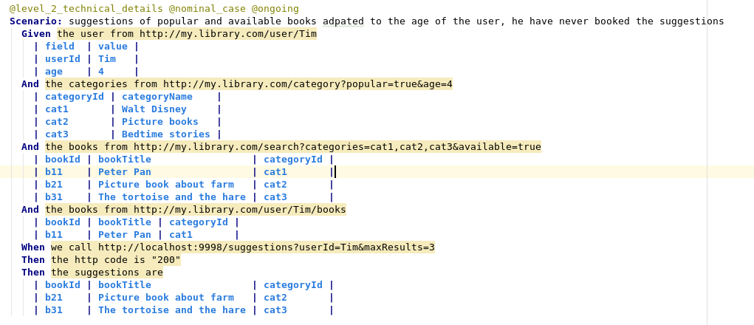
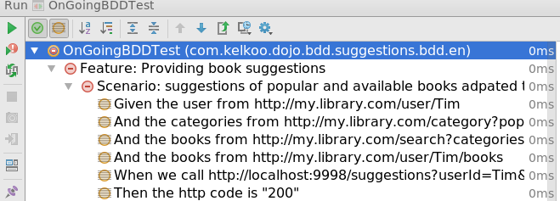
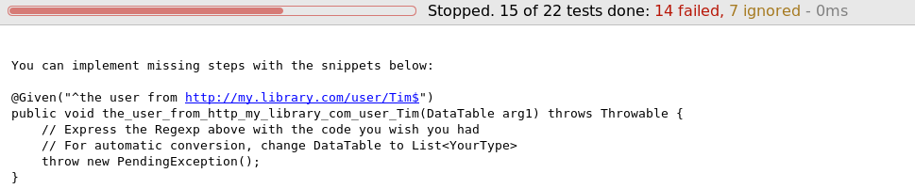
Library
Make scenario runnable
DEV
The dev is guided

Slide 39
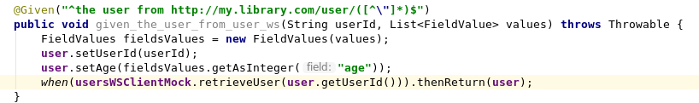
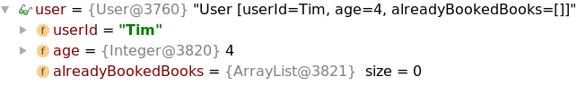
Library
Make scenario runnable
DEV
Glue code between steps and main code
Contextual variable

Slide 40
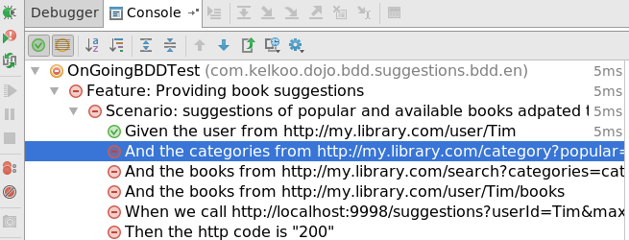
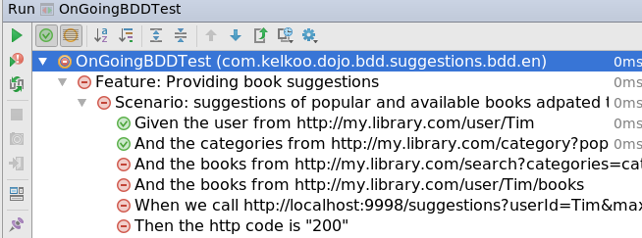
Library
Make scenario runnable
BDD
DEV
Define mocks behavior

Slide 41
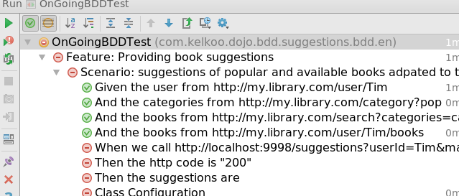
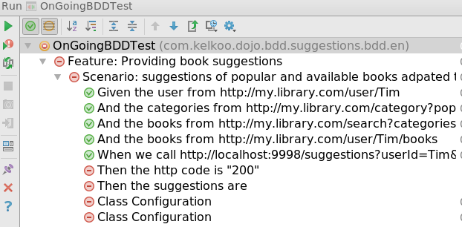
Library
Make scenario runnable
BDD
DEV
Main code call

Slide 42
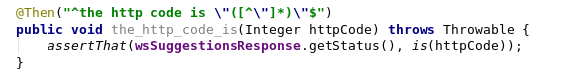
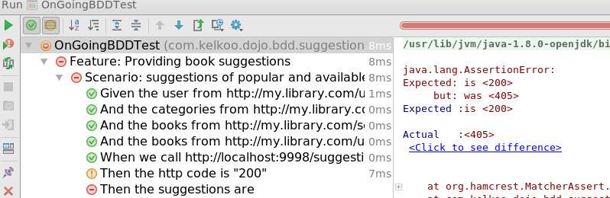
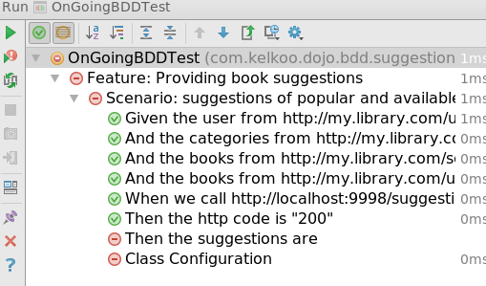
Library
Make scenario runnable
BDD
DEV
Main code does not exist….
Check results

Slide 43
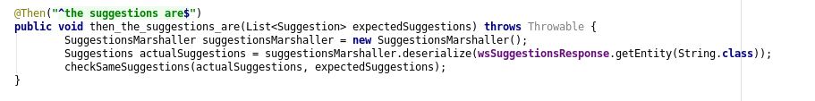
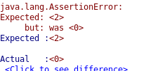
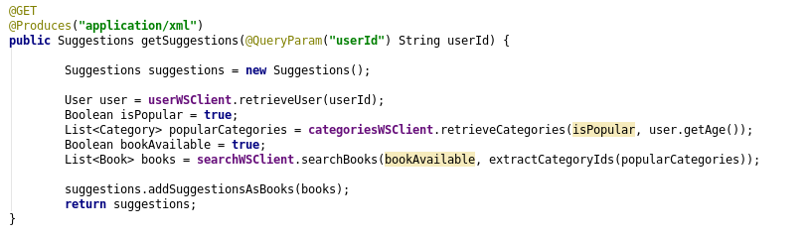
Library
Make scenario runnable
BDD
DEV
Let’s write the real code

Slide 44
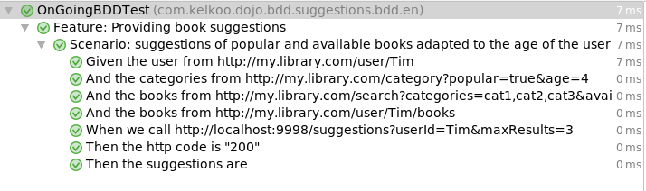
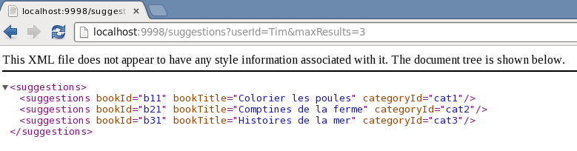
Library
Make scenario runnable
BDD
DEV
First implemented scenario !
The code is activated in the production conditions

Slide 45
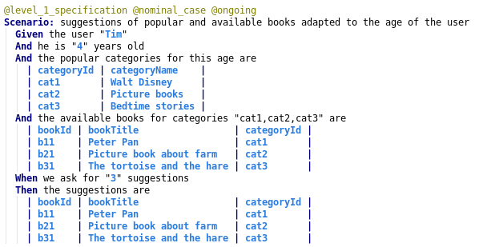
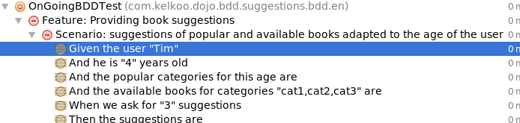
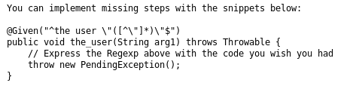
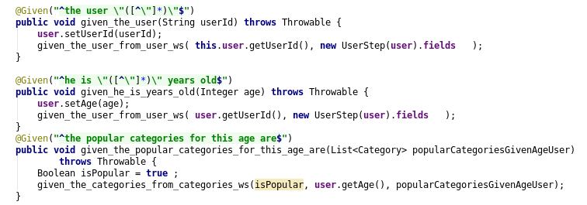
Library
BDD
Make scenario runnable
BDD
DEV
Reusing executable steps with a lower level of abstraction

Slide 46
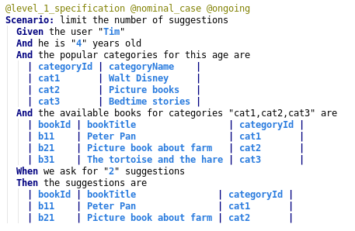
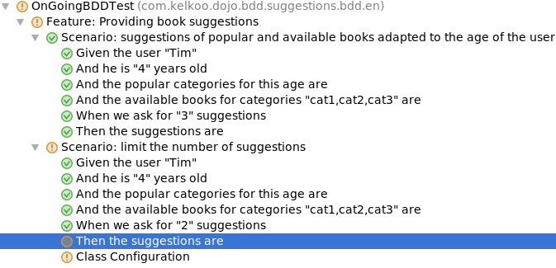
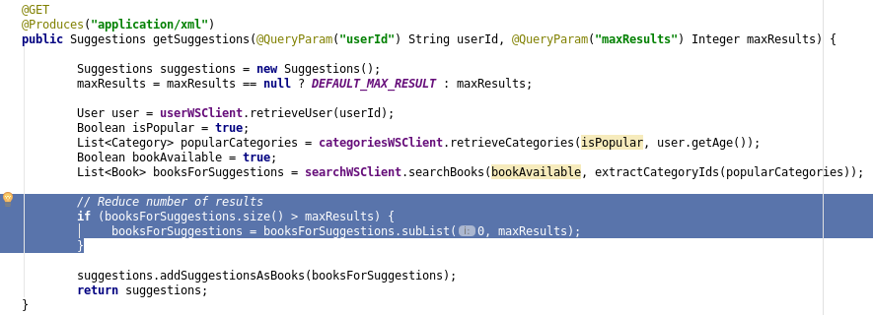
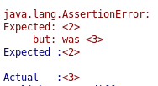
Library
BDD
Make scenario runnable
BDD
DEV
Reusing steps

Slide 47
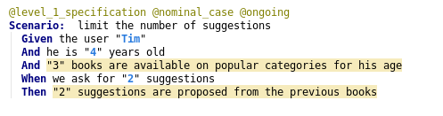
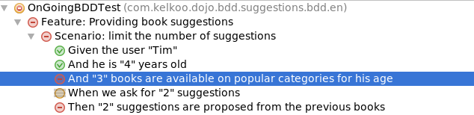
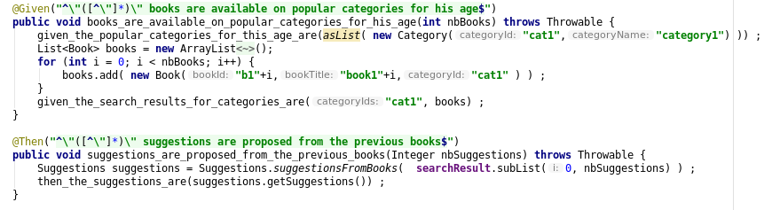
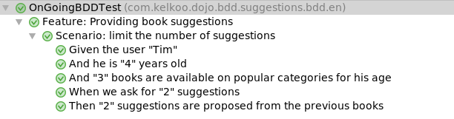
Library
BDD
Make scenario runnable
BDD
DEV
Generate data to make a scenario easier to read

Slide 48
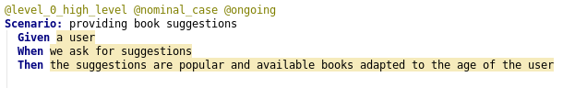
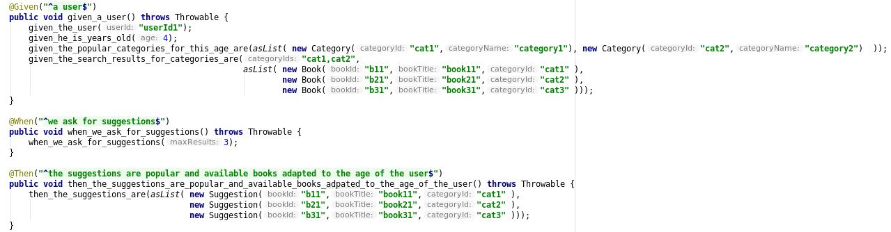
Library
BDD
Make scenario runnable
BDD
DEV
Implement a high level scenario

Slide 49
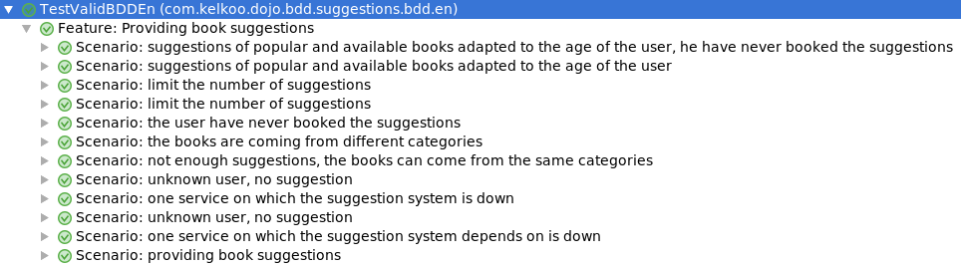
Library
BDD
BDD
Make scenario runnable
BDD
DEV
All scenarios are implemented

Slide 50
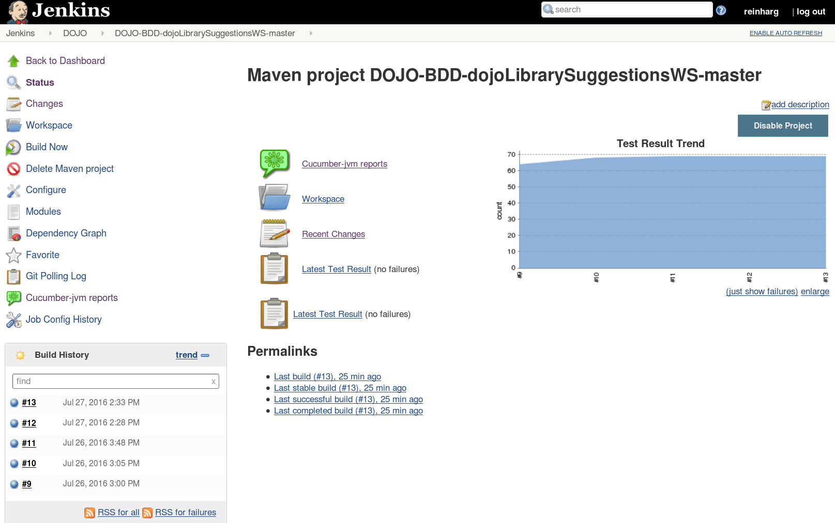
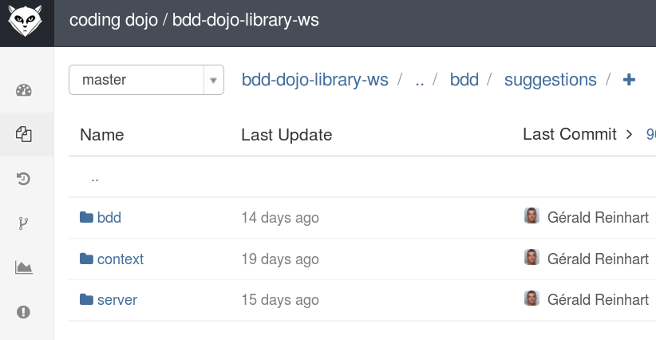
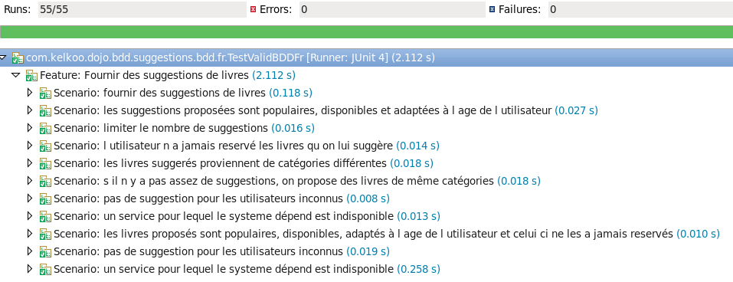
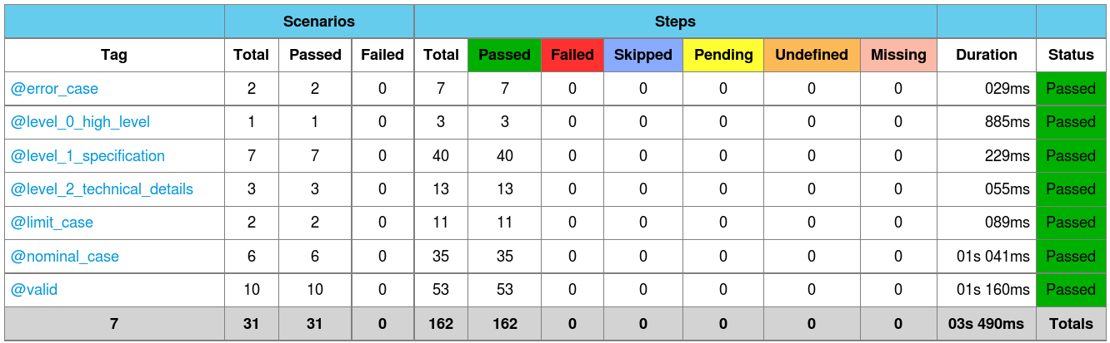
Library
Regression tests
Regular regression tests
DEV
Source code
@nominal
@limit
@error
@level_0
Scenario
Scenario
Scenario
Scenario
Continuous Integration
@level_1
Scenario
@level_2
Scenario
Scenario
Scenarios BDD

Slide 51

Improve the process
User Story
Emails
Acceptance
Criteria
Write scenarios so that both
PO and DEV can understand
PO
DEV
Wrote it with DEV
@nominal
@limit
@error
Wrote it with PO
@level_0
Implementation based on the scenarios
Scenario
Scenario
Scenario
Scenario
@level_1
Scenario
Difficult to access to the accurate documentation
@level_2
Scenario
Scenario
Anyone
Scenarios
Reflect features in production
Code is driven by scenarios
Move to production
Integration tests
Production

Slide 52
Improve the process
User Story
Acceptance
Criteria
Write scenarios so that both
PO and DEV can understand
PO
DEV
Wrote it with DEV
@nominal
@limit
@error
Wrote it with PO
@level_0
Implementation based on the scenarios
Scenario
Scenario
Scenario
Scenario
@level_1
Scenario
Search / Navigate by BDD Web App
@level_2
Scenario
Scenario
Anyone
Scenarios
Reflect features in production
Code is driven by scenarios
Move to production
Integration tests
Production

Slide 53
Conclusion
Specification by example
Close collaboration DEV / PO is required
Use examples to open discussion and find many cases
Allows a very fast feedback loop
Functional tests
Fast and stable tests
The developer is guided, the code is pulled by the tests
Flexible code is required to mock external interactions
Runnable Documentation
Pulled from code, the documentation is always up to date
The documentation is exhaustive
Notes:
Spécification par l'exemple
collaboration étroite DEV / PO est nécessaire
utiliser des exemples permet d'ouvrir la discussion et de trouver de nombreux cas
permet une boucle de rétroaction très rapide
définition au plus tôt de toutes les entrées sorties nécessaires
une User Story est déclinée en nombreux scénarios
les phrases exécutables sont réutilisables
découper les scénarios
garder uniquement le nécessaire
garder en tête la lisibilité
les données non nécessaires à la lisibilité peuvent être définies dans le code de test
ne pas hésiter à dérouler l'algorithme à partir des exemples du scénario
envisager différents cas : cas nominal, cas limite, cas d'erreur
organiser les scénarios : niveau d'abstraction, différents cas
Tests fonctionnels
le développeur est guidé, le code est tiré par les tests
on écrit uniquement le code nécessaire ni plus ni moins
tests exhaustifs
le code doit être flexible pour mocker les interactions extérieures
une boucle BDD induit plusieurs boucles TDD
tests stables : les interactions extérieures sont mockées
Documentation exécutable
issue du code, la documentation est à jour toujours
les niveaux d'abstraction permettent d'inclure une documentation adaptée au contexte de la documentation projet

Slide 54
Conclusion
The team is more welded around the project
same level of understanding for everyone
the scenarios constitute a clear contract
Trust
Velocity
very fast feedback loop for the PO
In case of change of orientation product, the modification of the tests and the code is faster

Slide 55
Conclusion
Failure factor
DEV or PO not involved
BDD applied during the project : need to be done a the very first step
aim is to address too important use cases not really addressed yet :
- easily access to the scenario
- collaborative tools to help PO and DEV discussion
=> https://github.com/KelkooGroup/theGardener/wiki

